Slide 1
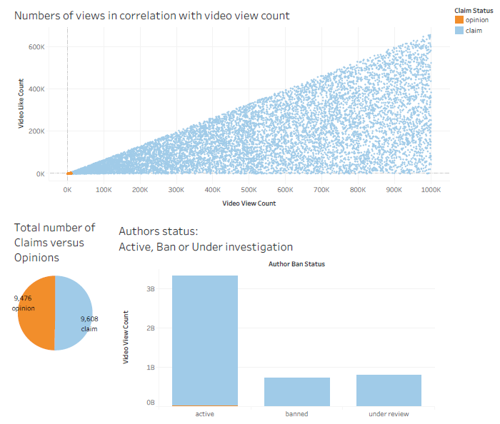
Claims classification project. Exploratory Data Analysis
Executive summary report
TikTok is working on the development of a predictive model that can determine whether a video contains a claim or offers an opinion. With a successful prediction model, TikTok can reduce the backlog of user reports and prioritize them more. At this stage of the project TikTok data Team perform Exploratory Data Analysis and provide detailed inside about findings
Number of claims and opinion from verified users much less than from the unverified users
The median view counts for non-active authors are many times greater than the median view count for active authors.
Video with claim status much more popular and have enormously more median views that video with opinion status
The overall view count is dominated by claim videos even though there are roughly the same number of each video in the dataset.
Since non-active authors are more likely to post claims, and that videos by non-active authors get far more views on aggregate than videos by active authors, then `video_view_count` might be a good indicator of claim status.
Determine what to do with missing data. Suggestion to delete it from data set as non significant
Determine strategy regarding outliers
To further investigate distinctive characteristics that apply only to claims or only to opinions.
To consider other variables that might be helpful in understanding the data

